Slide 1
Jal Shakti Data Portal
User Manual

Slide 2
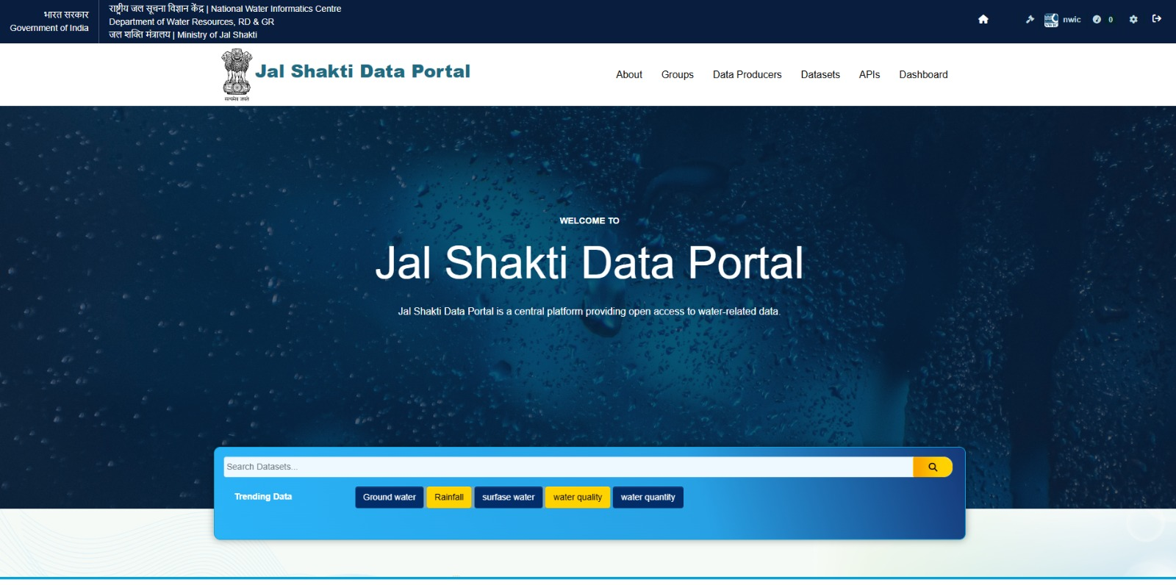
Jal Shakti Data Portal
Welcome to the Jal Shakti Data Portal, an open-data platform providing seamless access to water-related data. This manual will guide you through the portal's features, helping you explore, analyze and utilize data for informed decision-making in water resource management.
Our mission is to enhance transparency, foster innovation and support collaboration by offering reliable data sourced from multiple agencies. Jal Shakti Data Portal empowers stakeholders to drive sustainable water management solutions through improved knowledge sharing.
Notes:
2

Slide 3
Key Features and User Interface
Open Access
Single Source
All data is freely available for download and reuse, promoting transparency and collaboration.
A managed repository of water data sourced from various center and state agencies ensures easy access and consistency.
Jal Shakti Data Portal features open access to data, a single source of data, data standardization, data categorized in Groups and a user-oriented interface with clear metadata and search functions.
The portal also offers an open API catalog and trending search insights.

Slide 4
Home Page: Key Components of the Header Section
About: This section highlights that the portal has been developed as part of the approved roadmap and action plan for the National Water Informatics Centre (NWIC).
Groups: Groups are maintained to help users navigate and explore the datasets available on the platform. It includes basic information and links to the datasets.
Data Producers: The datasets are categorized according to various Central Agencies, State Agencies and other data producers which helps with the data contribution.
Datasets: The Datasets section is the central repository for all available datasets on the Jal Shakti Data Portal.
APIs: The APIs page enables developers to efficiently discover, learn about and integrate APIs.

Slide 5
Exploring the Homepage
1
About the Portal
2
Search and Filter
3
Trending
A brief introduction to Jal Shakti Data Portal, highlighting its mission to promote transparency and informed decision-making through open data access.
Advanced search bar to find datasets by keywords, topics.
Trending searches are visible near the search bar to highlight popular terms and topics.
Jal Shakti Data Portal homepage offers several key components for easy navigation and data discovery. These include the portal logo, a login tab for officials, groups and links to state agencies and other related portals.
Notes:
4

Slide 6
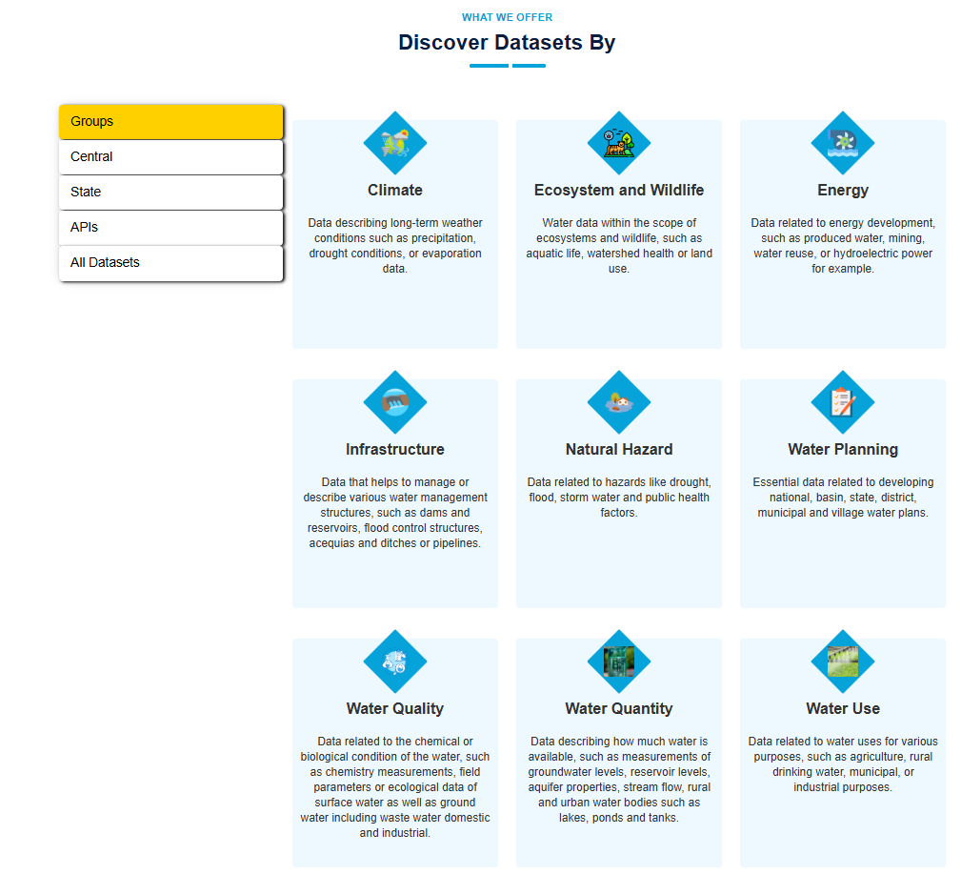
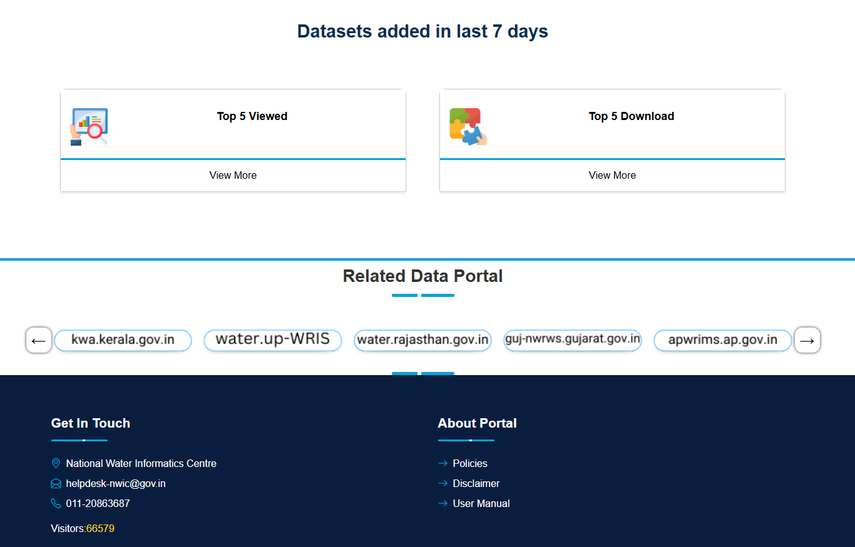
Homepage Analytics and Focus Areas
Discover Datasets By
Groups
Datasets added
Access datasets through various categories including Groups, Central and State agencies, APIs and All Datasets on a single page.
Data is organized into specific groups: Climate, Ecosystem and Wildlife, Energy, Infrastructure, Natural Hazard, Water Planning, Water Quality, Water Quantity and Water Use, ensuring easier navigation and access.
Top Viewed & Downloaded Datasets: A display of the five most-viewed and five most-downloaded datasets, helps in identifying popular and high-value datasets.
Related Data Portal: Provides links to other related data portals. These portals offer additional datasets, reports and resources focused on water resources, management and policies. By accessing these linked portals, complementary information can be explored. Direct links to state agencies are included for comprehensive access.
Notes:
6

Slide 7
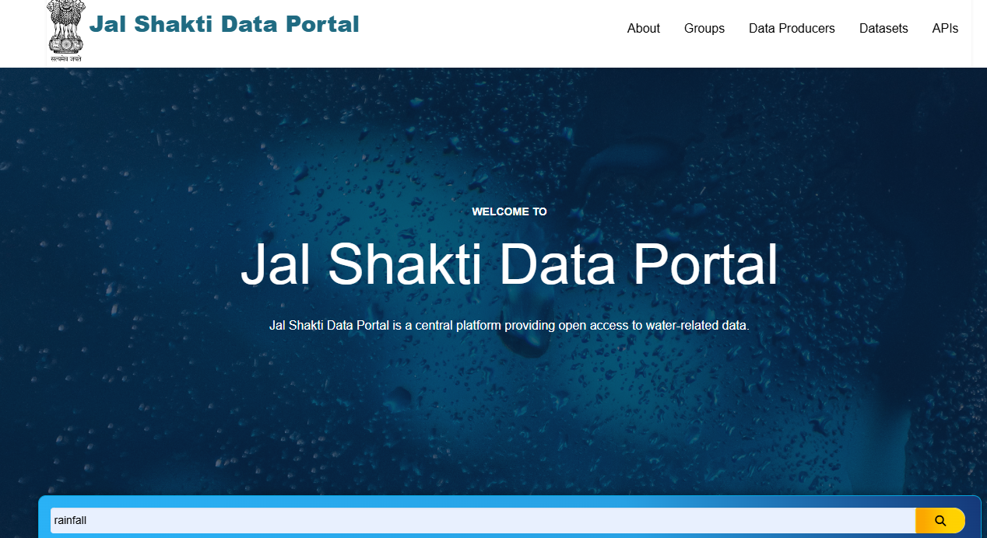
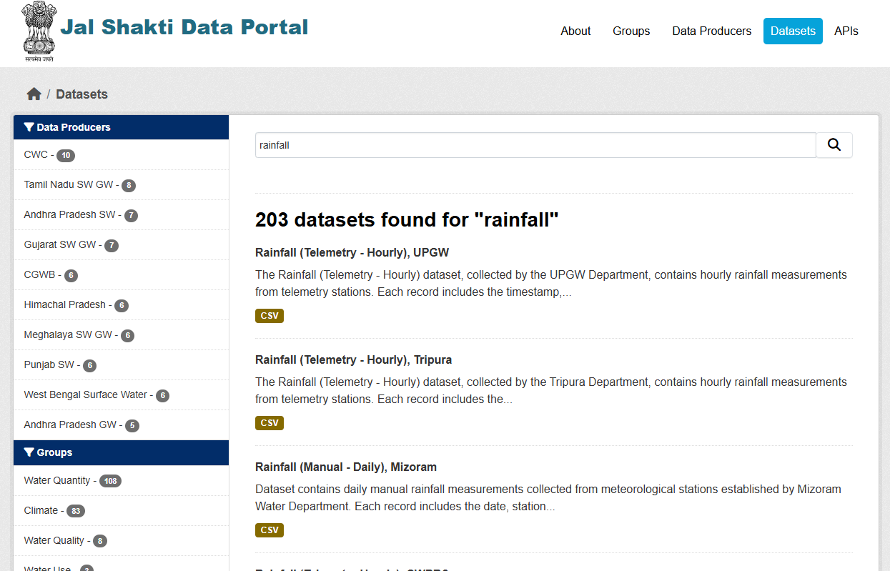
Step-by-Step Guide to Portal Navigation
Accessing the Portal
Open a web browser and enter the URL https://nwdp.nwic.in/ in the address bar. The homepage will load, displaying key components like the search bar and data categories.
Exploring Datasets
Click on the search bar, type keywords, and press Enter. The Datasets Page will open with search results. Use filters on the left sidebar to refine your search.
Accessing a Dataset
Click on a dataset title to open the Dataset Details Page. Click the Download button to get the file in your chosen format. If an API is available, click on API Endpoint for programmatic access.
Notes:
8

Slide 8
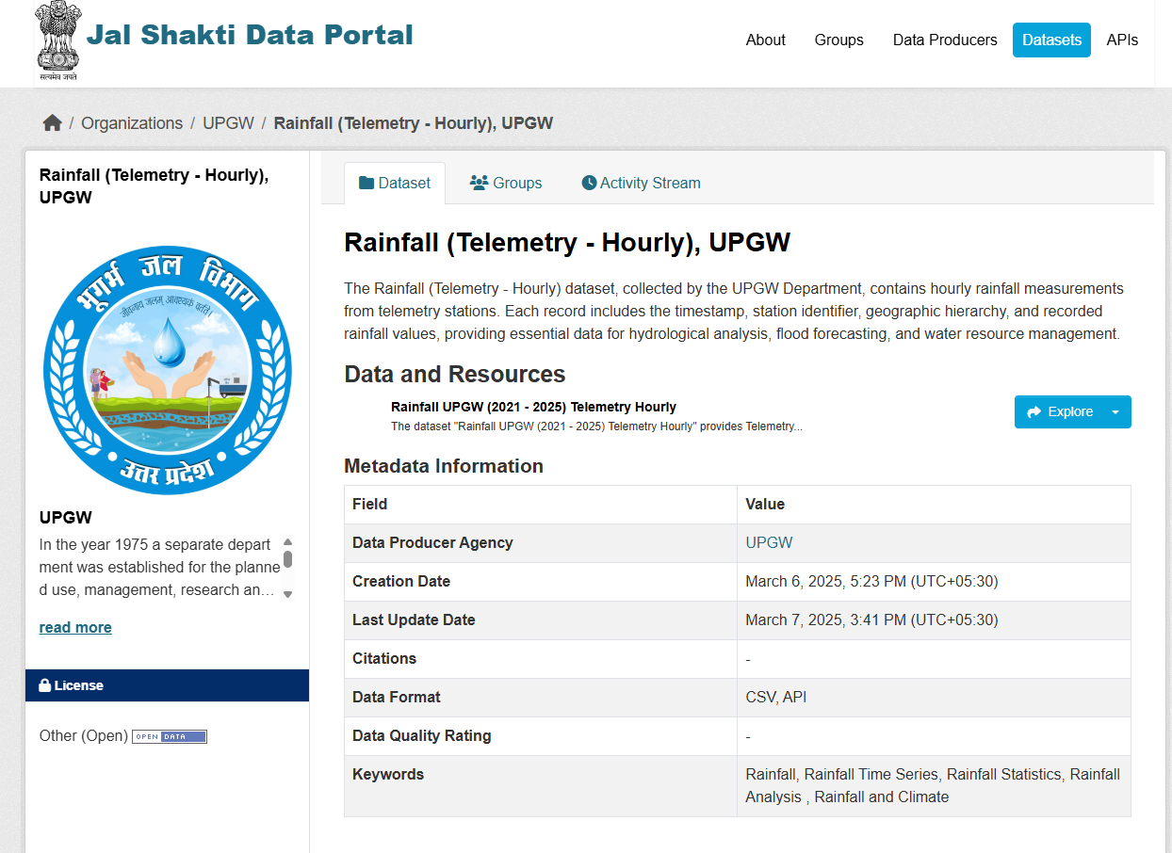
Navigation through
Search
1
Accessing the Portal
Open a web browser and enter the address https://nwdp.nwic.in/ .The homepage will load, displaying a search bar, trending results and groups.
2
Using the Homepage
Click on the search bar, type keywords and press Enter. Use filters in trending data to refine search results.
3
Navigating Datasets
The Datasets Page will display a list of datasets with titles, descriptions and data producers. Click on a dataset title to open the Dataset Details Page.
The left sidebar provides various filters, including Data Producers, Groups, Formats and Licenses. Additionally, datasets can be searched using the search bar at the top of the page.
Notes:
9

Slide 9
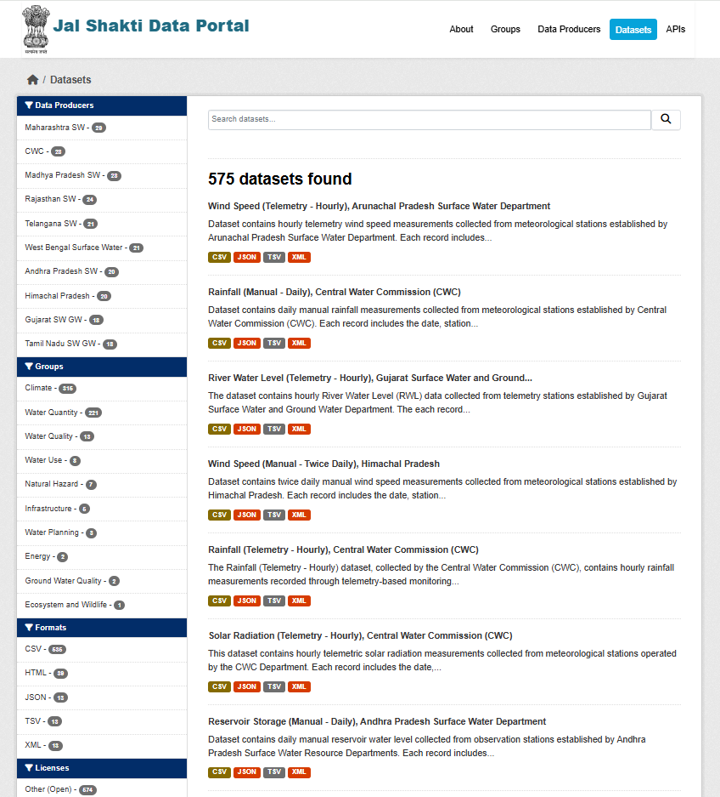
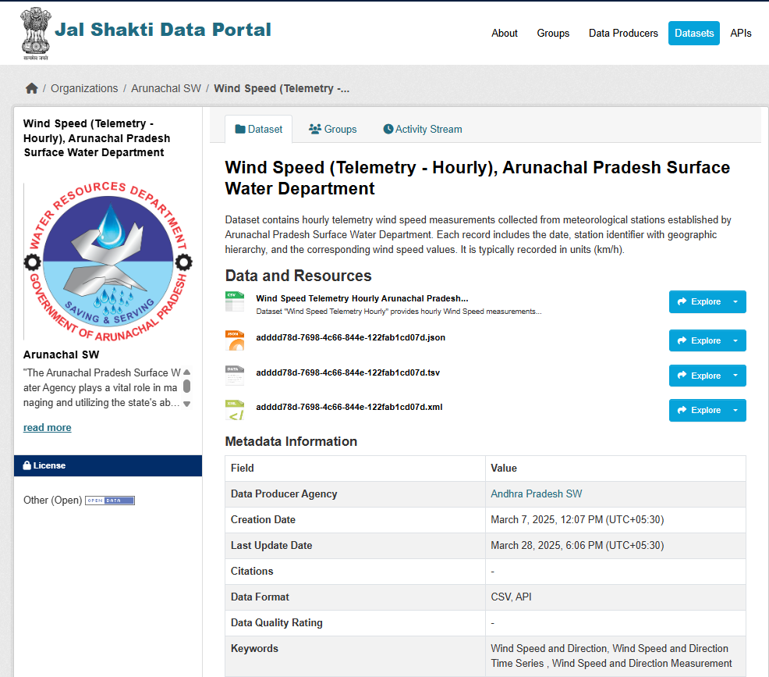
Exploring The Datasets
1
Accessing the Portal
Open a web browser and enter the NWDP address https://nwdp.nwic.in/ . The homepage will load, displaying a search bar, trending results, groups and data categories.
2
Using the Homepage
In the Header section, click on Datasets.
Navigating Datasets
3
The Datasets section offers comprehensive listings, advanced search and filtering options and detailed metadata for each dataset, ensuring users can easily find and understand the data they need. Click on a dataset title to open the Dataset Details Page.
The left sidebar provides various filters, including Data Producers, Groups, Formats and Licenses. Additionally, datasets can be searched using the search bar at the top of the page.
Notes:
10

Slide 10
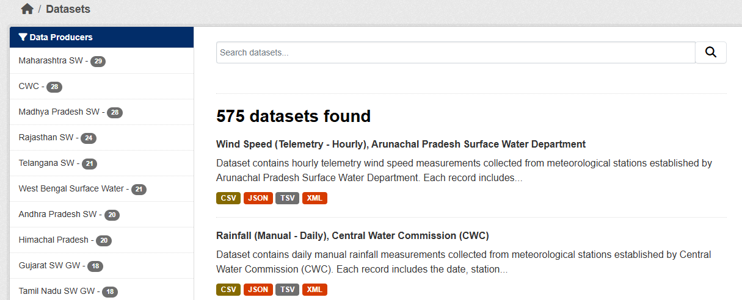
Key Features of Datasets
Comprehensive Listings
Each dataset includes a brief description and metadata for easy discovery.
Advanced Search
Users can input keywords to find specific datasets quickly. Filters include Data Producers, Groups, Formats and Licenses.
Dataset Metadata
Includes details such as Title and Description, Data Producer Agency, Creation Date, Last Update Date, Citations, Applicable Data Formats, Data Quality Rating, Keywords and Usage License.
Notes:
11

Slide 11
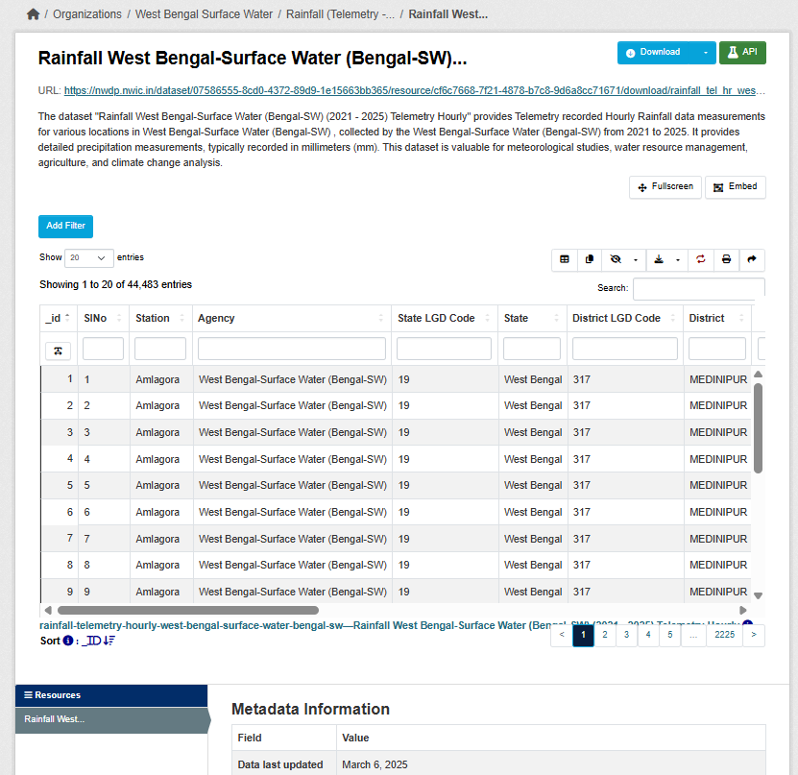
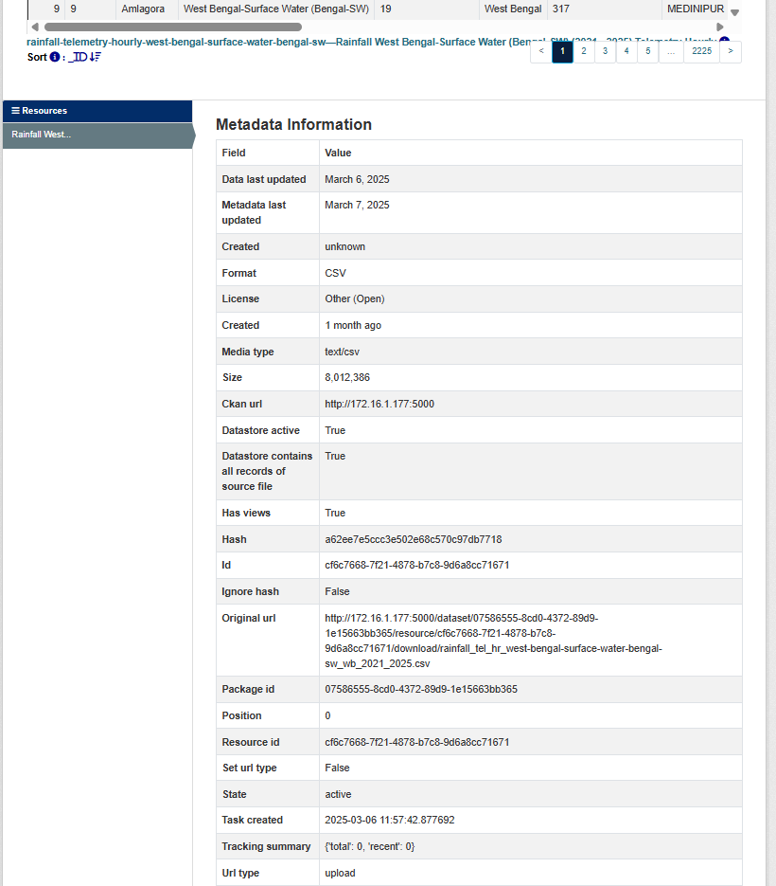
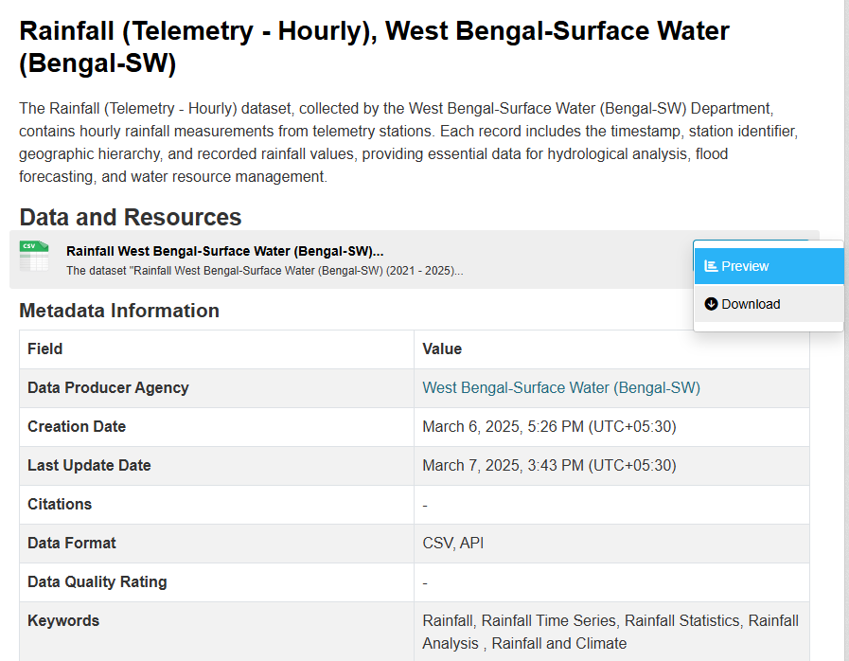
Datasets Page
Step 1: On the Datasets page, clicking the Explore button provides two options: Preview and Download.
Selecting Download allows users to directly download the dataset.
Step 2: In the Preview section, the corresponding datasets page is displayed.
Notes:
12

Slide 12
Datasets Page
On the Datasets Preview page, clicking the Add Filter button gives the filter to optimize the data according to the chosen fields.
Advanced Search:
Toggle Column Visibility
Share current view
Table/List toggle
Filtered Download
Reset
Print
Copy to Clipboard
Notes:
13

Slide 13
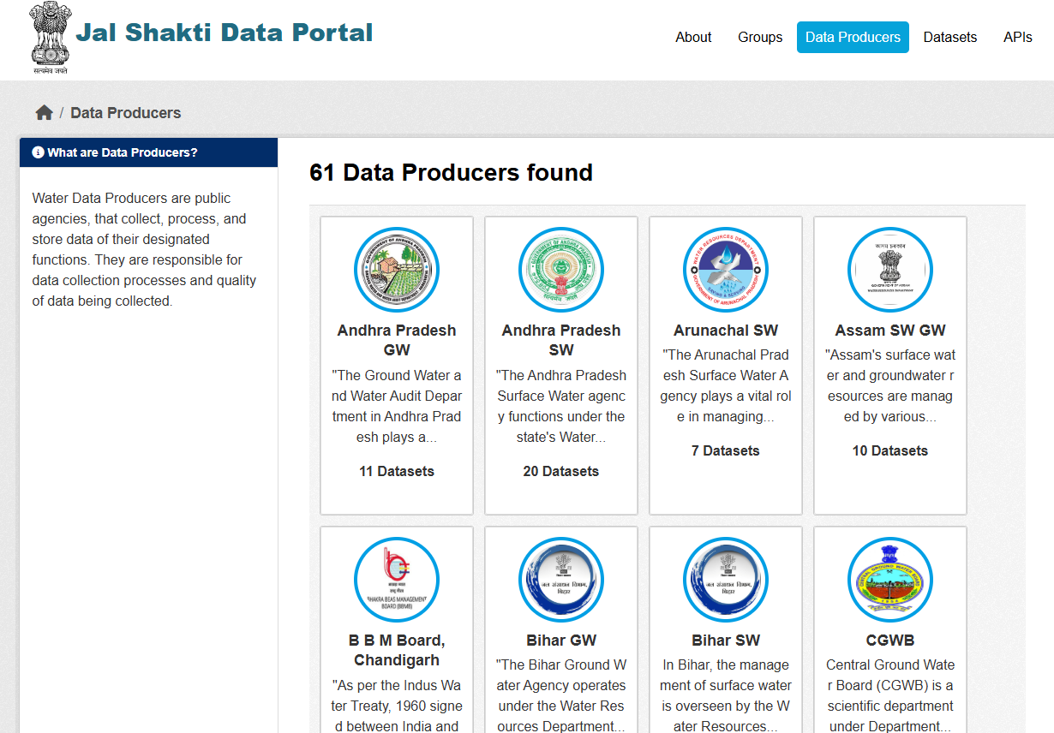
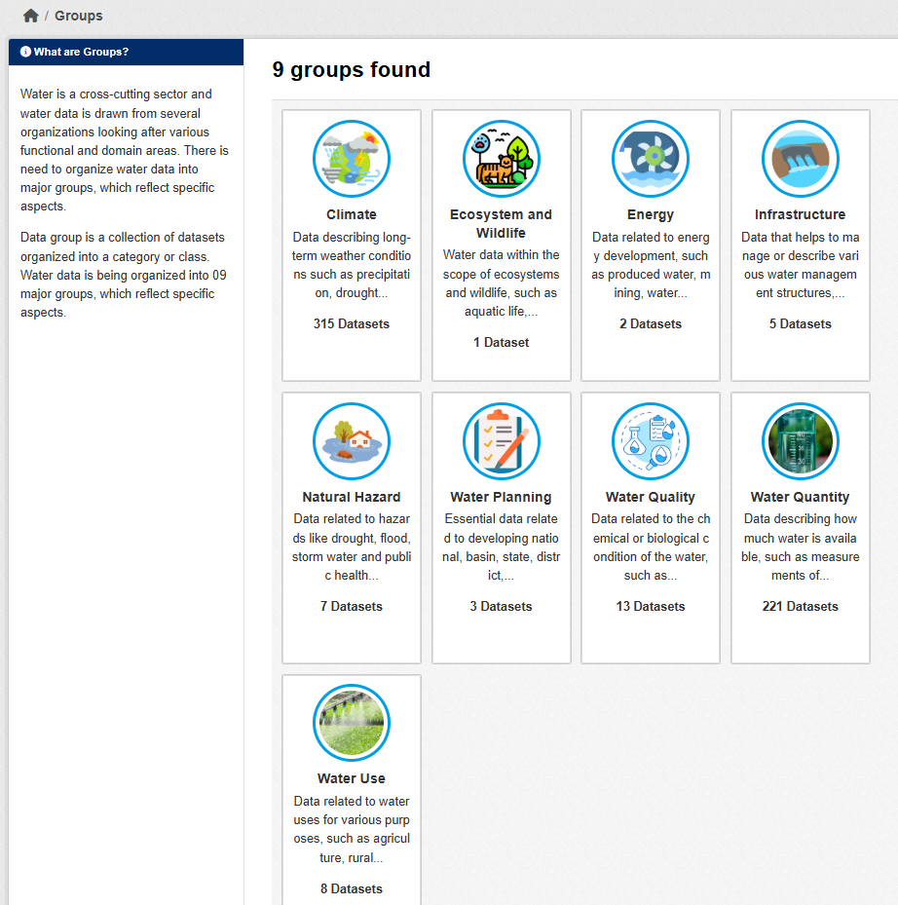
Exploring Additional Features
1
Browsing by Groups
On the homepage, click on Groups to view all nine dataset categories: Climate, Ecosystem and Wildlife, Energy, Infrastructure, Natural Hazard, Water Planning, Water Quality, Water Quantity and Water Use. Similarly, selecting any group on the homepage or the Groups page (e.g., Water Planning) will open a category page displaying related datasets, enabling focused exploration based on specific interests.
2
Viewing Data Producers
Click Data Producers in the top menu to see a list of agencies. Click on a data producer name to view datasets provided by them. This is useful for identifying specific data providers.
Notes:
16

Slide 14
Exploring the API Catalog
Data
In the Header section, navigate to APIs.
API Catalog: Query and Filter
The API Catalog contains the Dataset API which provides programmatic access to all the datasets in the portal. This API allows developers to query, filter and retrieve data directly from our repository in a structured, machine-readable format.
Integration
Clicking on any API requires filling in a few parameters.
Comprehensive documentation, including detailed endpoints, query parameters and code examples is provided to ensure a smooth and efficient development experience.
Notes:
15

